Slide 1
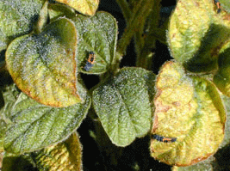
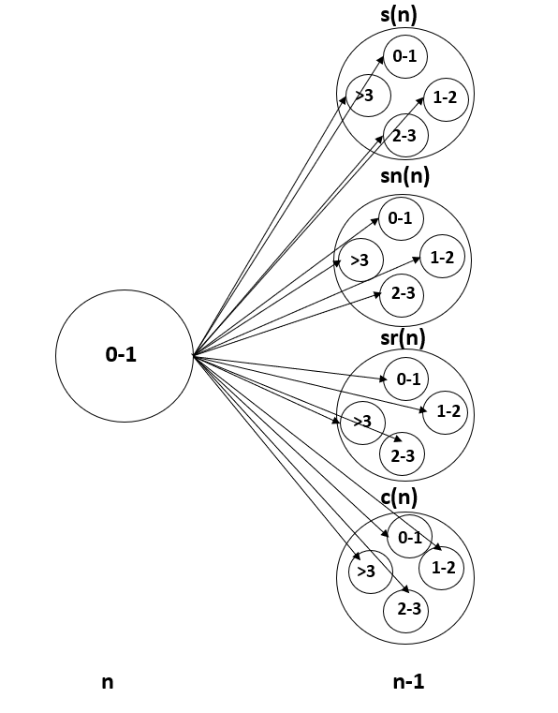
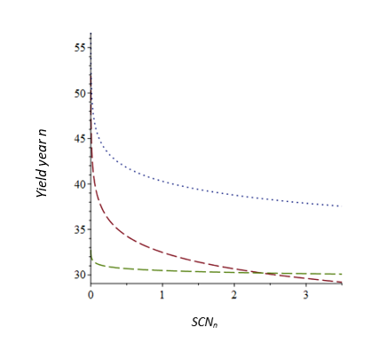
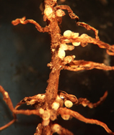
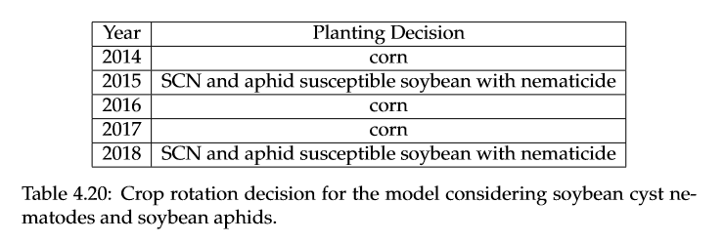
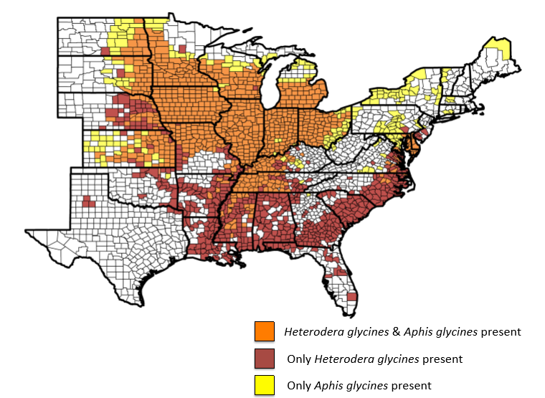
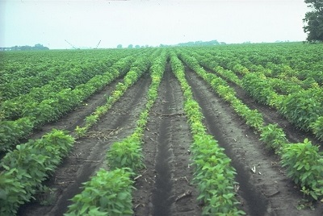
Optimizing Crop Rotations and Pest Management Strategies in Agriculture
.
.
By: Madeleine Ferguson Advisor: Dr. John Ramsay Department of Mathematics
Abstract
Pest and Pest Biology
The goal of this project is to investigate how mathematical models can be applied to crop rotation decisions in agriculture. One major concern that farmers face is pests. This project seeks to respond to this by solving optimization models that represent scenarios in which pests are present and pose a threat to yield. Two previously published models were replicated. A new model was created that optimizes ﬁeld crop rotations for ﬁve years in an ecosystem with two pests present.
Soybean Cyst Nematodes
Small soil-dwelling organisms that impact the roots of soybean plants and therefore overall crop yield at harvest.
Will not reproduce in the winter.
Population at the end of one season will be the same as the beginning of the next.
Equations for population dynamics and yield loss is given by researchers Zacharias, Liebman, and Noel [5].
Fig 5. Damage caused by soybean aphids [3].
Model
A dynamic programming model was used to optimize the crop rotation for each year. Dynamic programming models will solve the model from the final stage to the starting stage; it this scenario it will choose the crop rotation with the highest profit. Five management strategies are considered:
Aphid and SCN susceptible soybean
Aphid and SCN susceptible soybean
Aphid resistant and SCN susceptible soybean
Aphid susceptible and SCN resistant soybean
Corn
Figure 5 shows an example of what the dynamic program would look like. In this problem we define n to be the number of seasons to finish. Looking at Fig 5, we see that in order to solve year n-1 we need to know the starting SCN level in year n-1 as well as the planting decision of year n.
Fig 6. Green line represents SCN resistant, red represents SCN susceptible, and blue represents nematicide.
Objective
To created a model to optimize the crop rotations of a soybean farm over five years in a system where soybean cyst nematodes and soybean aphids are present. Figure 1 shows that both pests are present in the same regions therefore making it important to understand how they interact.
Fig 5. Example of model.
Table 1. Five-year crop rotation.
Fig 1. Map of Midwest depicting areas the pests' impact [2].
Fig 3. Soybean Cyst Nematodes[4].
Fig 4. Soybean aphids [1].
Conclusion
This work helps to understand and recognize the role that agricultural pests play in agriculture. There are several options for future work of this project including adding a corn pest, as well as improving the aphid-soybean relationship to closer reflect what is observed in the field.
Soybean Aphids
Results
Infest the leaves of soybeans
Known to cause high damage in years of an infestation.
Overwinter on the buckthorn bush before migrating in the summer to soybean fields.
Model assumes an infestation once every three years.
Model assumes all infestations have the same amount of damage.
Table 1 depicts the optimal crop rotation.
Fig 6 helps us understand why pesticide is chosen in this model over other management options.
This model was found to be relatively insensitive after considering starting infestation level, timing of infestation, yield equations, and a fertilizer option.
References
Heppner, Kelvin. “Soybean School: Taking a Closer Look at Soybean Aphid Thresholds.” RealAgriculture.com, 18 Aug. 2017, www.realagriculture.com/2017/08/soybean-school-taking-a-closer-look-at-soybean-aphid-thresholds/.
Michael Thomas McCarville. PhD thesis, 2014.
“Pest & Crop Newsletter.” August 1, 2003 - Issue 20, Pest & Crop Newsletter, Entomology Extension, Purdue University, extension.entm.purdue.edu/pestcrop/2003/issue20/.
“Soybean Cyst Nematode.” CropWatch, University of Nebraska-Lincoln, 22 July 2019, cropwatch.unl.edu/plantdisease/soybean/soybean-cyst-nematode.
Thomas P Zacharias, Judith S Liebman, and Gregory R Noel. Management strategies for controlling soybean cyst nematode: an application of stochastic dynamic programming. North Central Journal of Agricultural Economics, pages 175–188, 1986.
Tylka, Greg. “Soybean Growers Need an Integrated Approach When Fighting Nematode.” News, Iowa State University Extension and Outreach, www.extension.iastate.edu/news/soybean-growers-need-integrated-approach-when-fighting-nematode.
Fig 2. Crop damage by soybean cyst nematodes [6].

