Slide 1
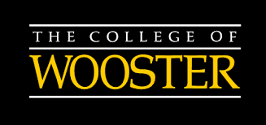
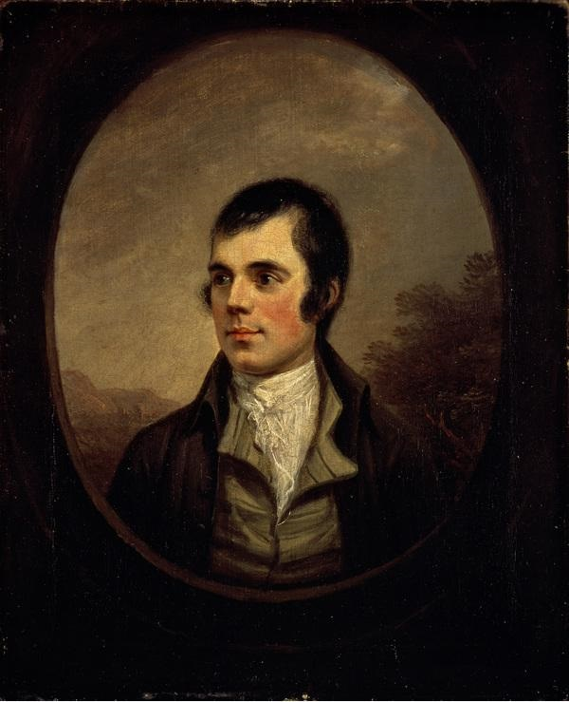
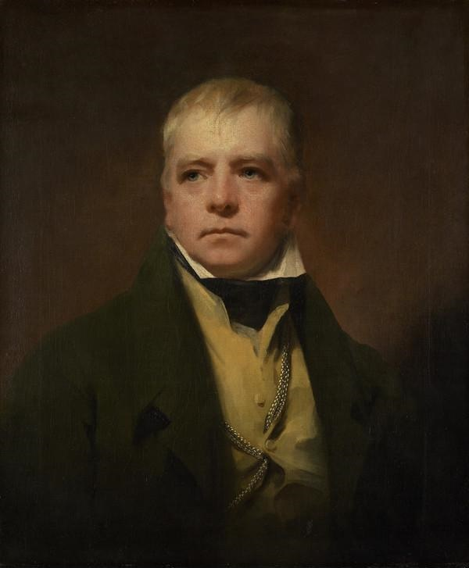
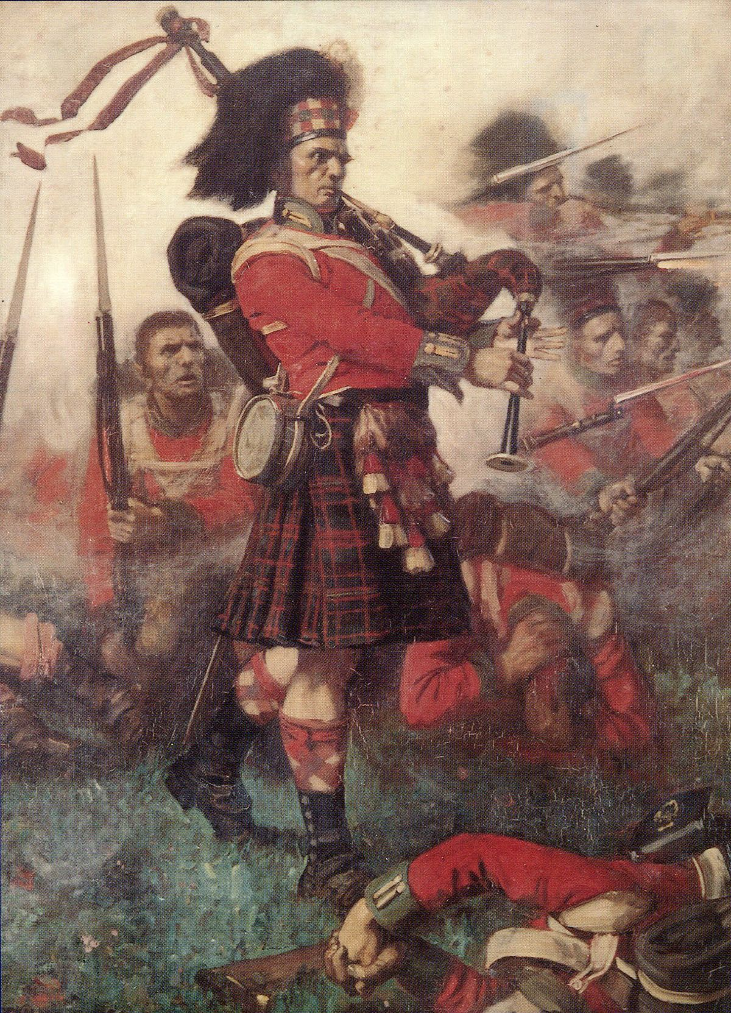
Redemption of the Gàidhealtachd: The Formation of Highlandism from 1745 to 1822
Isaiah Corso-Phinney
Advisor: Dr. Jeff Roche
Analysis
In the aftermath of the Jacobite Rebellion of 1745, Highland culture was at its lowest in terms of influence on Scottish national identity.
With the formation of the Highland regiments, the British government found that the Highlanders could be used as tools for fighting in foreign wars, namely the Seven Year’s War and the Napoleonic Wars.
The antithesis of this military transformation can be seen in piper Kenneth MacKay, who bravely played the bagpipes while in the line of fire at the Battle of Waterloo.
The famed poet Robert Burns wrote numerous poems that noted the bravery of the Highlanders and sympathized with the destruction of their way of life after the Jacobite Rebellion of 1745.
Burns also produced songs, such as Scots wa hae, that promoted a radical form of Scottish nationalism that quite separated itself from a British heritage.
Novelist Sir Walter Scott produced the narrative poem Lady of the Lake, which glamorized the physical landscape of the Highlands, even causing a tourist boom in the Highlands described in the poem.
Scott also penned Waverly, which romanticized the Highlanders way of life and portrayed the Jacobites with dramatic Romanticism.
By stage-managing George IV’s visit to Scotland and imbedding Highland imagery, Scott associated the Highlands with the image of Scotland itself.
Robert Burns
By Alexander Nasmyth
Scottish National Portrait Gallery, Edinburgh
Sir Walter Scott
By Sir Henry Raeburn
National Galleries Scotland, Edinburgh
Abstract
Conclusions
From the end of the Jacobite Rebellion of 1745 to the Royal visit of George IV to Scotland in 1822, there was a radical transformation of how Highland culture was perceived. Once viewed as barbarous, the culture of the Scottish Highlands came to be seen during the late 18th and early 19th century as both symbols of Scottish identity and Scottish Nationalism. This movement is called Highlandism. The beginnings of this movement can be traced back to the formation of the Highland regiments, which were composed of men from various regions of the Highlands. In addition to the Highland regiments, the poet Robert Burns and novelist Sir Walter Scott both contributed to Highlandism’s success by producing works that humanized and romanticized the Highlanders.
The Question: How did Highlandism form and become apart of Scottish national identity? How was Highlandism able to contribute to Scottish nationalism?
The Argument: I argue that the success of the Highland regiments and the select works of Burns and Scott promoted the use of Highlandism as a force for Scottish nationalism.
The beginnings of Highlandism begin with the formation of the Highland regiments, specifically the 42nd regiment, The Black Watch. Due to the success of the Highland regiments, they played a tremendous role to the development of a Scottish military identity.
Robert Burns promoted Highlandism with his numerous works praising the highlanders as men of worth and valor. Burns also promoted Highlandism with songs that promoted Scottish Nationalism.
Sir Walter Scott was perhaps the most instrumental in the development of Highlandism. His works, specifically Lady of the Lake and Waverly, promoted the romantic image of the Highlands in both the land and the people that lived there. Finally, he stage-managed the visit of George IV to Scotland and filled it with Highland imagery, even having the King wear the dress of a Highland Chief.
Sources and Suggested Readings:
Methods
Scot, Walter. Waverly. The Penguin English Library. Harmondsworth, England: Penguin, 1. 985
Burns, Robert – “The Highland Widow's Lament.” BBC. BBC. Accessed September 15, 2019. http://www.bbc.co.uk/arts/robertburns/works/the_highland_widows_lament/.
Devine, T. M. The Scottish Nation: A History, 1700-2000. 1st American ed. New York: Viking, 1999.
Strachan, Hew. “Scotland’s Military Identity.” The Scottish Historical Review 85, no. 220 (2006): 315–32.
The use of Primary Sources:
Historical Records of Highland regiments, particularly The Historical Records of the 79th Queen's Own Cameron Highlanders.
Works by Robert Burns and Sir Walter Scott.
The use of scholarly articles about Highlandism, Scottish national history of the 18th and 19th centuries, and the works of Burns and Scott.
Biographies of both Robert Burns and Sir Walter Scott.
Piper Kenneth MacKay, 79th Cameron Highlanders at Waterloo.
By Lockhart Bogle
From Trustees of the Highlanders Museum

