Slide 1
A Predictive Model for Coach Firings in NCAA Division I Men’s Basketball
Presentor: Eli Samuelson
Advisor: Drew Pasteur

Slide 2
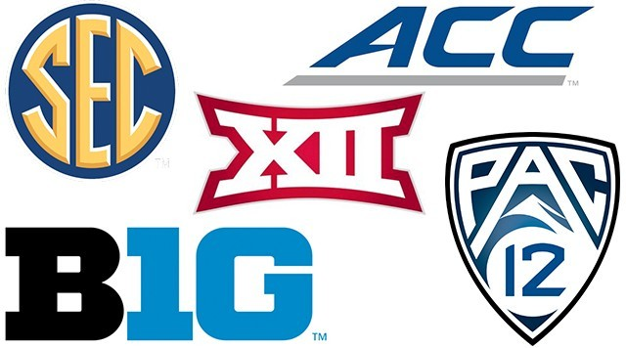
Background
Dataset
Power 5 conferences
ACC
SEC
Big 10
Big 12
Pac-12
Training: 2009-2010 - 2015-2016
Testing: 2016-2017 - 2018-2019

Slide 3
Training
Years
2009-2010 to 2015-2016
Coaches fired in 2009-2010
Variables
Win Loss Percentage
General
Conference
SOS (Strength of Schedule) and SRS (Simple Rating System)
NCAA Tournament Variables
First Round, Sweet 16, Elite Eight, Final Four, Championships
Years Coaching (At the school)
Coach Turnover Rate

Slide 4
Results
Logistic Regression
Important Variables
Winning Percentage, Years Coaching, Sweet 16 appearances, Turnover Rate
Random Forest
Important variables
Winning Percentage, YearsCoaching, SRS, TurnoverRate, Conference Winning Percentage, Sweet 16 Percentage, NCAA apperances, SOS

Slide 5
Testing on Power Five Conference Data
2018-2019 Power 5 Season (7 out of 57 coaches fired)
Coach | School | Firing Probability | Fired or not
Chris Collins | Northwestern | 0.598 | Not Fired
Bryce Drew | Vanderbilt | 0.349 | Fired
Ernie Kent | Washington State | 0.291 | Fired
Danny Manning | Wake Forest | 0.270 | Not Fired
Wyking Jones | California | 0.269 | Fired
Steve Alford | UCLA | 0.241 | Fired
Logistic Regression

Slide 6
Testing on Power Five Conference Data
2018-2019 Power 5 Season (7 out of 57 coaches fired)
Random Forest
Coach | School | Firing Probability | Fired or not
Avery Johnson | Alabama | 0.442 | Fired
Andy Enfeild | USC | 0.420 | Not Fired
Chris Collins | Northwestern | 0.382 | Not Fired
Jim Larranga | Miami (FL) | 0.322 | Not Fired
Steve Alford | UCLA | 0.366 | Fired
Richard Pitino | Minnesota | 0.294 | Not Fired

Slide 7
Testing on Non-Power Five
2018-2019 Sun Belt Season (3 out of 12 coaches fired)
Logistic
Regression
Coach | School | Firing Probability | Fired or not
Phil Cunningham | Troy | 0.612 | Fired
Jim Fox | Appalachian State | 0.292 | Fired
Darrell Walker | Little Rock | 0.203 | Not Fired
Random
Forest
Coach | School | Firing Probability | Fired or not
Keith Richard | Louisiana-Monroe | 0.394 | Not Fired
Phil Cunningham | Troy | 0.354 | Fired
Mark Byington | Georgia Southern | 0.328 | Not Fired

Slide 8
Conclusion
My Models
Generalizable
Logistic Regression over Random Forest
2019-2020 Season?
Issues with this season
Future Work
Larger Data Set
Salary
Connection to NBA

Slide 9
Sources
https://www.sports-reference.com/cbb/
Chapter 12 logistic regression.
https://www.stat.cmu.edu/ ̃cshalizi/uADA/12/lectures/ch12.pdf.
Lorraine Li. Classification and regression analysis with decision trees.https://towardsdatascience.com/https-medium-com-lorrli-classification-and-regression-analysis-with-decision-trees-c43cdbc58054, May 2019.
Sarang Narkhede. Understanding AUC - ROC Curve.https://towardsdatascience.com/understanding-auc-roc-curve-68b2303cc9c5, May 2019.
Tony Yiu. Understanding random forest.https://towardsdatascience.com/understanding-random-forest-58381e0602d2, Aug 2019.

