Slide 1
The Song of Siros
John-Paul Richard
English & Russian

Slide 2
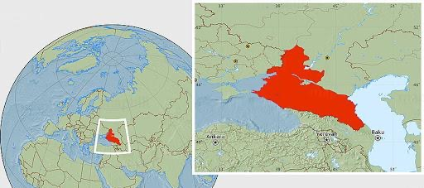
Origin
Черномазый / черножопые
N-word without the American connotations / Black ass
Ideas of blackness & dirtiness due to being “Othered”
Huge amount of ethnicities
Playing with the multitude of minorities both in the US and in Russia

Slide 3
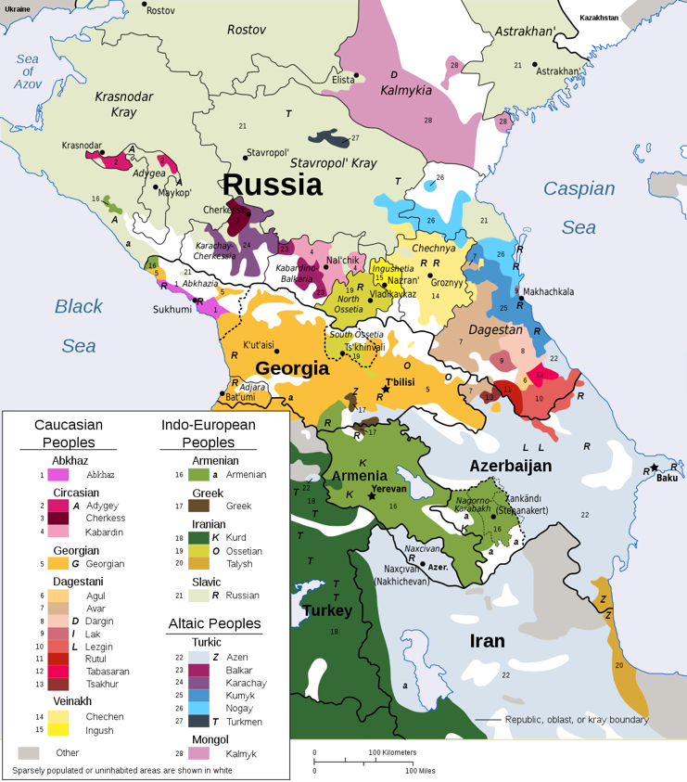

Slide 4
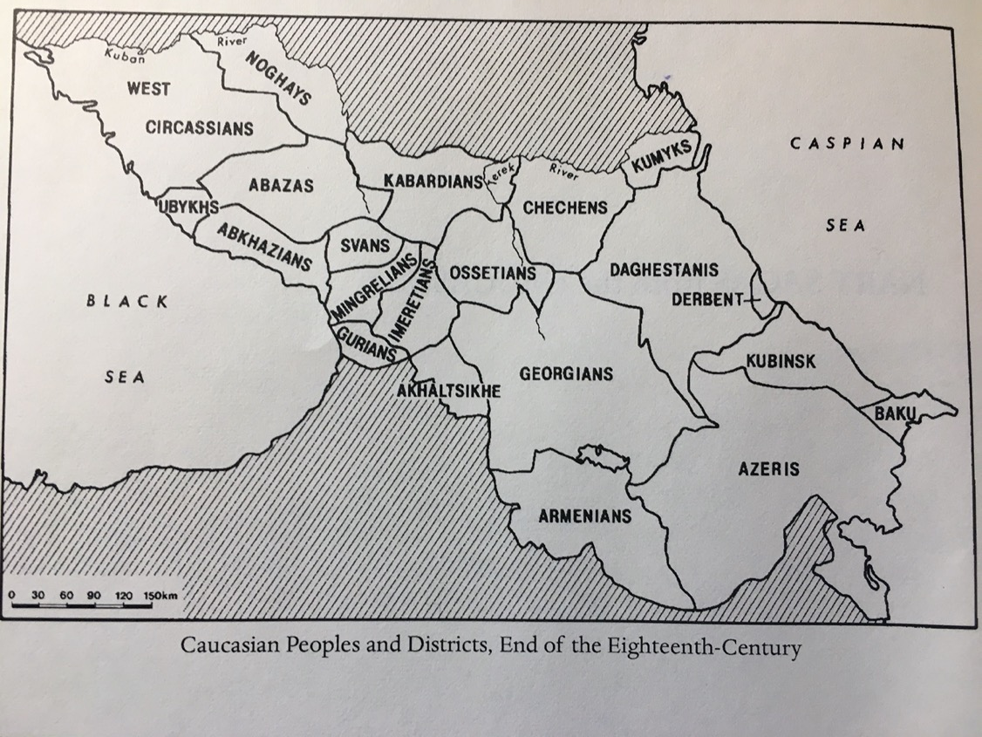

Slide 5
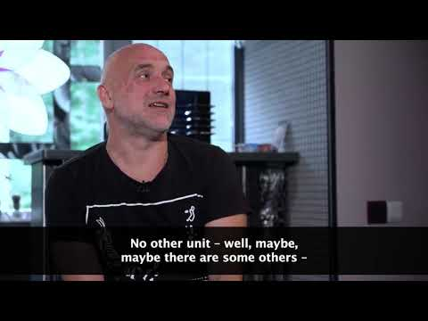
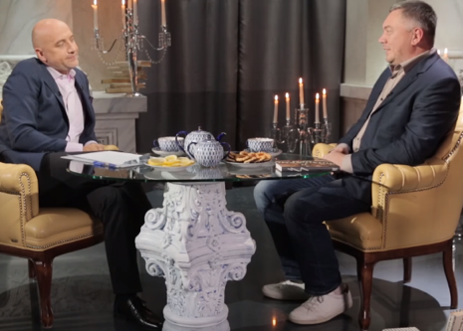
Junior IS
Russia
Caucasus (Кавказ)
Chechnya
German Sadulaev
Zahar Prilepin

Slide 6
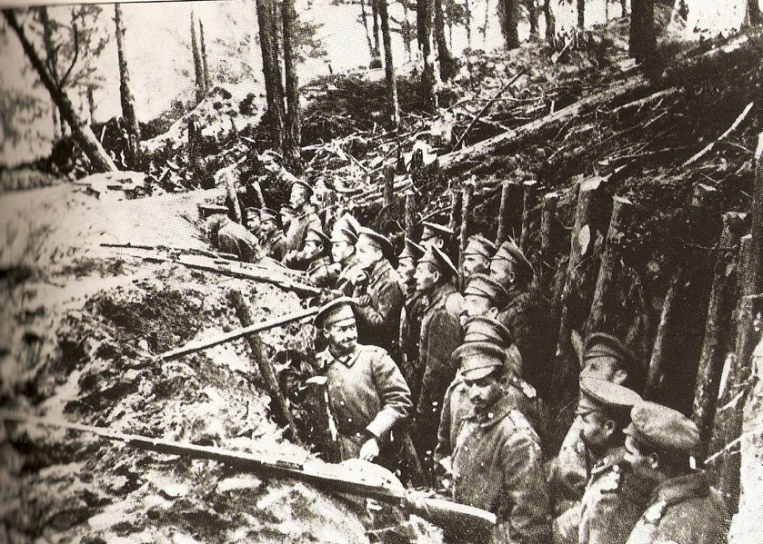
Senior IS
Epic Poem (We’ll dip into this in a sec just sit tight)
WW1 Caucasus trench
Dynamic cast of characters
Enough with those damn white boys, the rest of us want some war trauma too!
Main themes
Political polarization
Minorities vs. Majorities
The nature and dynamics of storytelling
Fighting toxic masculinity sprinkled in for taste

Slide 7
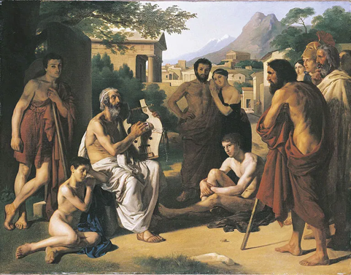
Forms
Oral Indications
Epics are naturally not written so I had a bit of an issue
Theory about Sappho translations
Spatial Indications
I’d rather tell a visual story than just textual
Language Indications
Eugene Onegin stanza
Free Verse
Barzelletta
Form Indications
Intro vs. the Epic

Slide 8
Story Synopsis
The epic opens on a cold South Caucasus WW1 trench. Siros, the protagonist-ish, an Englishman is on night watch and takes a moment to flashback to how he got from England to the Caucasus. After that journey, we are introduced to three brothers Ivanushka, Lensky, and Pyotr. Ivanushka is the youngest and likes food, Lensky is the middlest and likes reading and philosophy, while Pyotr is the oldest and is built like a brick wall. Lensky asks Siros to tell the rest of the restless crew a story. They all have told the same Caucasus classics over and over and want to hear someone who had a different background and experiences tell a story. They hunker down as Siros begins his story, unaware of the trials to come.

Slide 9
Excerpt 1
And here, Lensky doubled over, walked over,
And commented on the rather metallic quality of the air,
Then yelled something about “Pyotr’s favorite trick”
Lensky took his brown fur cap, and stuck it on a shit-soaked stick,
They both nodded and took up on either of his sides,
Slowly raising it up until just the top barely showed,
Then like thunder crack the stick was hit, and splintered over his shoulder,
The two comrades shot up, shot the muzzle flash,
Their bullets entering both The Bougie’s shoulders at the top and met in his spine,
Rendering from his slab of a neck down dead flesh,
Though very much alive for the moment, he didn't last long,
Unable to move his neck he was left face-down in
The sludge
Sucked inwards instead of the air he so desperately needed to scream
Sticking to the inside of his lungs and throat
Drowning any noises he made en ultimum

Slide 10
Excerpt 2
Siros wept
Silent, as he had no anger to voice
Going limp against Coandă,
He started to pull back once he could breathe again
And realized what he looked and sounded like
But Coandă never retracted or gave any indication of bore
And Siros broke down again
Tumbling into pieces,
As if Coandă was trying to hold a sandcastle
Which was slowly crumbling into the tide
When Siros genuinely began to breathe normally,
Coandă put his arm around his shoulders again,
And led him outside to an unrestricted night view
Untainted by man made light of any sort,
The stars and height of the heavens making their hearts
Miss
Every
Other
Beat
Standing on the precipice of eternity
They gazed into infinity

Slide 11
Thanks for reading i truly appreciate it
I hopefully will be submitting this piece for publishing but I don’t know if it will be accepted

