Slide 1
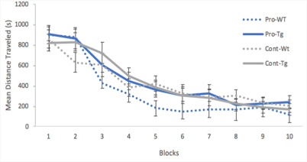
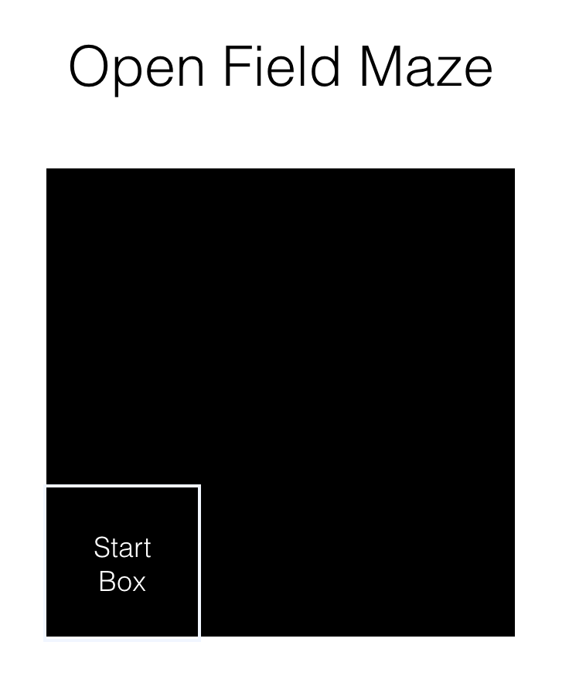
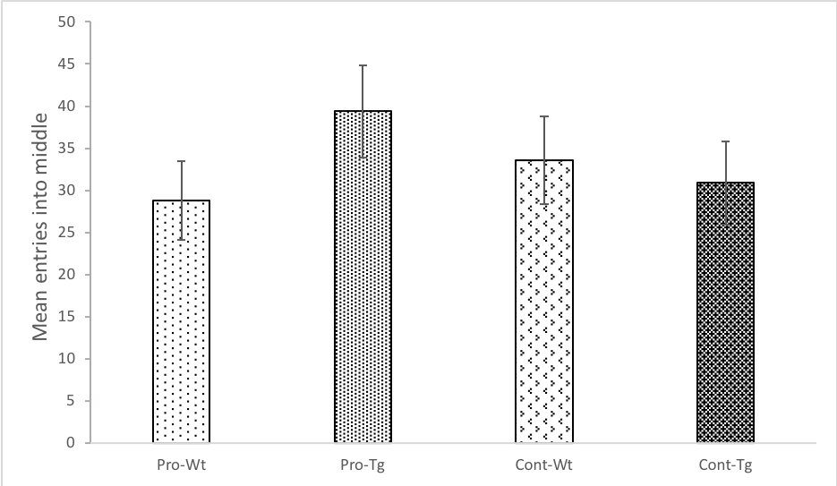
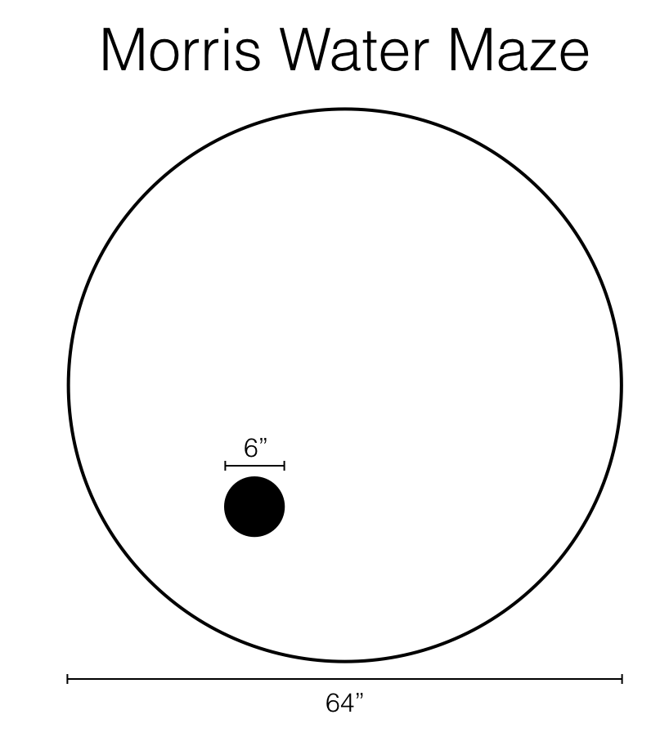
The Effect of an Antioxidant Supplement on a Mouse Model of Alzheimer’s Disease
Cognitive Behavioral Neuroscience Major
Jennifer Grossmann Advised by Dr. Amy Jo Stavnezer
Research Question
Will an antioxidant supplement prevent the brain degradation and resulting memory loss attributed to Alzheimer’s Disease (AD) in a mouse model?
Experimental Setup and Design
Morris maze – Distance to platform
 | No Treatment | OTC Antioxidant
Transgenic (AD Mouse Model) | n = 9 | n = 8
Wild-type (No AD) | n = 8 | n = 9
Supplementation of OTC antioxidant phytochemical mixture (Protandim) beginning at 3 weeks and supplemented for 3 months
Background And Significance
AD affects approximately 5.8 million people in the United States alone, and can cause debilitating symptoms such as memory loss, depression, confusion, and loss of physical functions.
There are currently no treatments that slow or stop AD progression.
Antioxidants have been found to combat oxidative stress and reduce chronic inflammation, both of which plague those with AD (cite).
Oxidative stress is an imbalance of reactive oxygen species (ROS) and the naturally occurring antioxidant enzymes that break them down. Oxidative stress is thought to be a part of the processes that occurs in AD (cite).
Protandim is an antioxidant-rich dietary supplement that is comprised of five herbal ingredients, and available over-the-counter (OTC).
The mice used in this study were bred to contain five gene mutations that significantly increase the chances of developing AD-like pathology along with learning and memory deficits.
The current study explores the impact of an antioxidant supplement (Protandim) on the behavioral changes in a rodent model of AD.
Method and Results
There was a significant reduction in mean distance traveled over blocks.
However, there was no difference between supplement or AD genotype in learning.
Open Field Maze
Mice are placed in a large open box for 5 minutes and activity and location is recorded
Time in the middle is a measure of anxiety, with more time in the middle indicative of less anxiety.
Conclusions
Although our OTC antioxidant supplement (Protandim) was not found to induce changes in the behavior of the mice in this study, perhaps adjustments in the length of time or start time of providing the supplement could produce significant results.
In addition, a different dose for mice may be necessary.
There is still a possibility for antioxidant supplements to improve deficits due to Alzheimer’s Disease, perhaps a different dietary supplement could produce positive results, or perhaps we need to acquire our antioxidants through our diet, such as the Mediterranean diet.
Open Field – Entries into the Center
No significant differences were found, indicating that the antioxidant did not alter innate levels of anxiety
References
2012 Alzheimer’s disease facts and figures. (2012). Alzheimer’s & Dementia, 8(2), 131–168.
Pham-Huy, L. A., et al. (2008). Free radicals, antioxidants in disease and health. International Journal of Biomedical Science : IJBS, 4(2), 89–96.
Valko, M., et al. (2005). Metals, Toxicity and Oxidative Stress. Current Medicinal Chemistry, 12(10), 1161–1208.
Velmurugan, K., et al (2009). Synergistic induction of heme oxygenase-1 by the components of the antioxidant supplement Protandim. Free Radical Biology and Medicine, 46(3), 430–440.
Acknowledgements
I want to thank every person who made this project possible including my advisor Dr. Stavnezer, Julie Pringle, Eleni and Alison, my teammates and Coach, friends, and of course my family.
Morris Water Maze
Mice are placed in a large water filled tub, with a platform hidden beneath the surface of the water. They must learn to swim to that platform, as a reward, from various start locations.
6 trials each day, 60-sec. each trial.
Path is recorded and digitally analyzed.
Hypothesis:
Supplementation of an OTC antioxidant will significantly improve AD-associated loss of memory by improving performance in the behavioral tests compared to the control animals.
Notes:
1
1
1
1

