Slide 1
Audio and Visual Processing of Horror
Timothy perales
Supervised by John Neuhoff
Is symposium presentation 2020

Slide 2
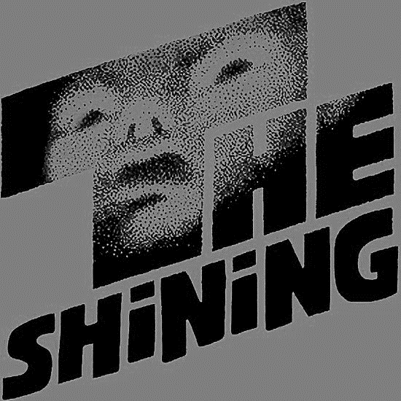
Introduction – IS Topic
A lot of the ideas that went towards settling on my final IS topic came from two classes – one where I began to research infrasaound and how sound can affect emotional states, and another where I completed a project about the aesthetics and psychology of horror films.
I’ve always had a personal love of horror, and the ability to research the neuroscience behind the genre called to me.

Slide 3
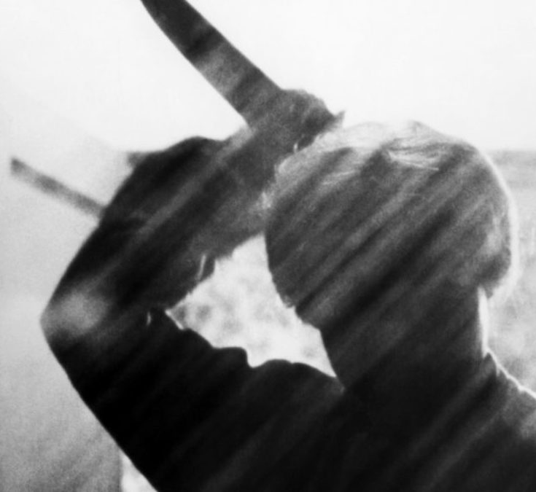
Introduction - Horror
Horror films have unique aesthetic properties, including genre-specific visual and audio queues
Examples include masked men, gleaning butcher knives, skulls, and of course

Slide 4
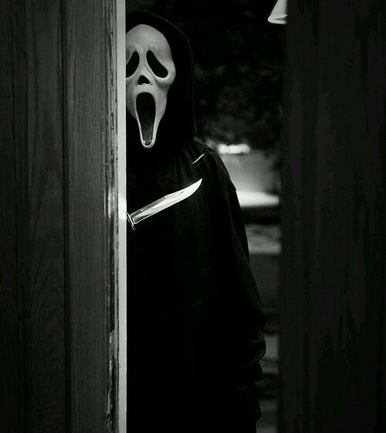
Introduction - Screams
Screams!
A true staple of the horror film across all generations and sub-genres.
What’s interesting about them…
When we scream, we force out a lot of air through our vocal folds which pushes our voices to their maximum output
This makes evolutionary sense – an early human that was capable of effectively alerting others in the immediate area would be more likely to survive than one that can’t.

Slide 5
Introduction - Nonlinearity
Screams and other distress cries necessarily push the vocal tract to its limit, and as a result creates a sound that fluctuates rapidly in volume and pitch
These fluctuations make the soundwave forms non-linear

Slide 6
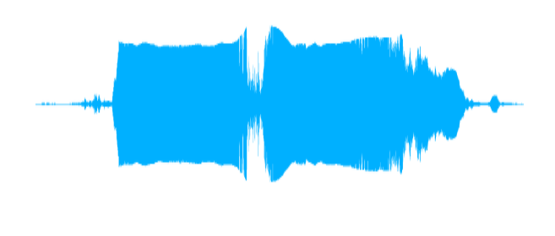
Waveform Examples
Woman screaming:
A flute:
Source: Samplefocus.com

Slide 7
Introduction – Neural Circuitry
Horror films are full of these nonlinear sounds that are mimicking distress cries
Distress cries draw on specific neural circuitry involved in fear processing, importantly including the amygdala.
The amygdala is used for fight or flight response generally, and its activation typically causes deactivation of frontal and prefrontal areas, making higher-order/logical thought more difficult when we are in fight or flight mode.

Slide 8
Introduction - Summary
Horror films use unique visual and audio queues that tap into the neural circuitry of fear.
Nonlinear audio
Violent, threatening visuals often involving a weapon
Research Question:
Are these unique properties of horror more powerful than ecologically valid fear stimuli?
Ecological validity = Stimuli that already exist in the environment
For humans, snakes are an example of an evolutionarily conserved and ecologically valid fear stimuli.

Slide 9
Methods
88 participants
Placed in 1 of 4 conditions:
Shown several image arrays while hearing condition-specific audio.
Linear audio = sine wave B3 note
Nonlinear audio = Sound sample of birds screeching from Alfred Hitchcock’s The Birds
Wave form of nonlinear stimuli:
Linear Audio – Snake Visual | Linear Audio – Horror Film Visual
Nonlinear Audio – Snake Visual | Nonlinear Audio – Horror Film Visual

Slide 10
Methods – Image Arrays
3 types of arrays:
Control (no fearful stimuli present, all nature control images)
Horror genre (1 horror image present, 4 nature control)
Snake (1 snake image present, 4 nature control)
All arrays used images from the International Affective Picture System (IAPS)

Slide 11
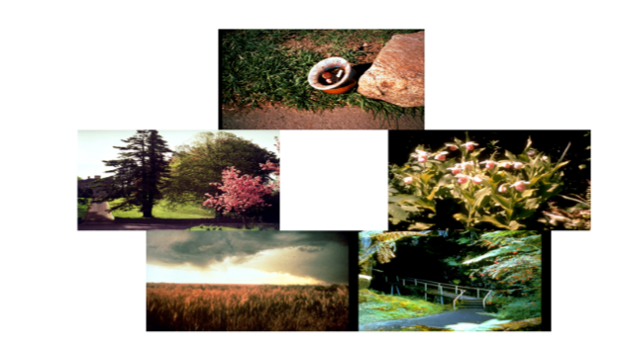
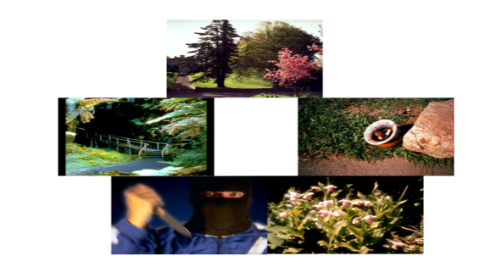
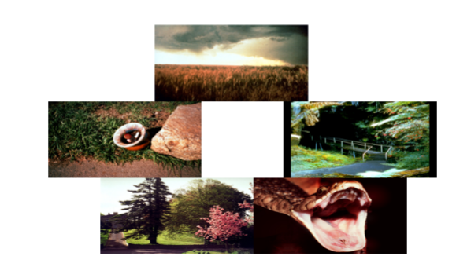
Methods – Image Arrays Con’t
Control Horror Snake
All participants shown a total of 10 control arrays and 10 fearful arrays based on condition assignment. e.g. 10 control arrays and 10 snake arrays

Slide 12
Methods – Reaction Time
Participants were tasked with identifying whether a fearful image (snake or horror genre) was present in each array.
Their reaction time (RT) to make this identification for each array presented was the dependent measure for this experiment.

Slide 13
Results
No significant main effects of audio type of fearful stimuli type, but a significant interaction between the two variables.
Generally, reaction times in nonlinear audio conditions were longer than those from linear audio conditions, and horror image conditions also typically had longer response times than snake image conditions.

Slide 14
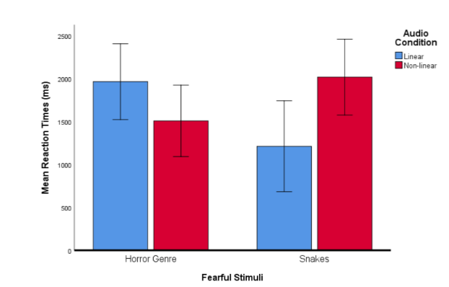

Slide 15
Discussion
No significant main effects likely due to sample size/cost
More participants could give “better” data, but the significant interaction found in this experiment shows that there is some connection between fearful visual stimuli and linearity/nonlinearity of audio stimuli.
Applications and generalizability
The results of this study could be used primarily as a launch point for further research that could further examine and clarify what the relationships are between ecologically valid vs nonvalid stimuli as well as the specifics of how different audio wave forms cause different perceptions in participants.
While limited in scope, this study did provide a sliver of insight into how human cognition and audiovisual processing is affected by specific forms of fearful stimuli.

Slide 16
End

