Slide 1
The Effect of Violence and Active Gameplay on Recognition of Advertisements in Video Games
By: Charlie Quigley
Advisor: Nathaniel Foster

Slide 2
Prior Research
Violence in the media has shown to lead to worse memory of advertisements in television shows with violence (Bushman, 1998; Gunter et al., 2005).
Violence also leads to worse memory of brands in video games (Lull et. al., 2018).
No previous research on passively watching video games and its impact of memory of brands.

Slide 3
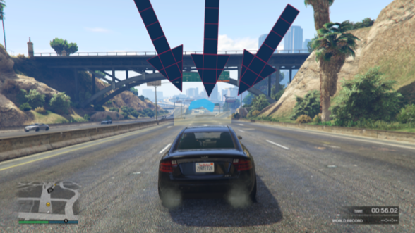
Method
Four conditions
Active – Violent
Passive – Violent
Active – Non-violent
Passive – Non-violent
Play or watch a GTA 5 race
Complete a recognition task of billboards in the game
Yoked design – each passive participants watches an active participant’s play-through
What participants see when playing

Slide 4
Results & Discussion
2 x 2 Analysis of Variance
Two independent samples t-tests
I observed a significant difference in recognition scores between the violent and non-violent participants in the active group
Replicating prior research, the non-violent participants performed significantly better on the recognition task than the non-violent participants.
There was not effect of passive versus active video game interaction on recognition memory
Billboard in the game and recognition task

Slide 5
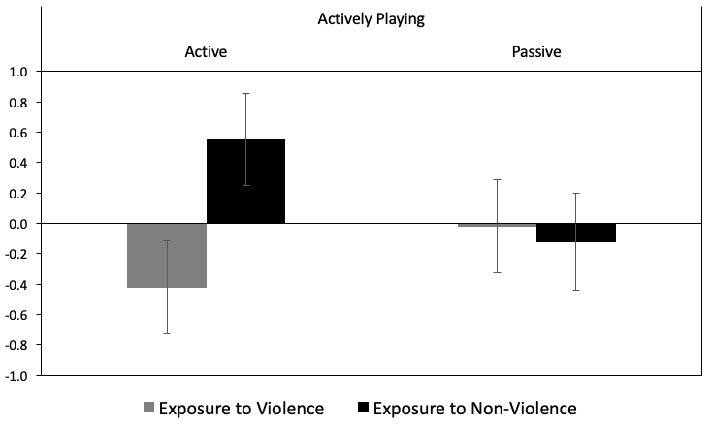
Mean recognition score. Error bars represent standard error of the mean.

