Slide 1
The Effects of Culture and Self-Stigma on Public Perception and Mental Health Attributions
Dena Nashawati
Advisor: Nathaniel Foster
Wooster Department of Psychology

Slide 2
Introduction
Purpose: evaluate the effects that different cultures and perspectives have on the stigma of mental health
Goal: specifically look at Japanese and American students in terms of culture instead of race or ethnicity
Notes:
Previous studies in the area of mental health stigma have shown that minority and ethnic groups tend to have higher negative stigma regarding people with mental health issues. In turn, people in these minority groups are less likely to seek help when needed, resulting in poor treatment in the community
some Eastern cultures emphasizing spiritual and supernatural causes and Western cultures emphasizing biological causes
parental beliefs and self-stigma also impact mental health attributions and help- seeking

Slide 3
Questions and Hypotheses
Japanese: higher rates of supernatural, normalization attribute
2nd-point-of-view: higher rates of personal attribute
How does culture affect mental health attributions?
When presented with a 2nd point-of-view vignette, will the results change?
Notes:
Japanese groups will have higher rates of supernatural/religious, Just World, and normalization attribute
American groups will have higher rates of biological attribute
2nd point-of-view groups will have higher rates of the personal attribute

Slide 4
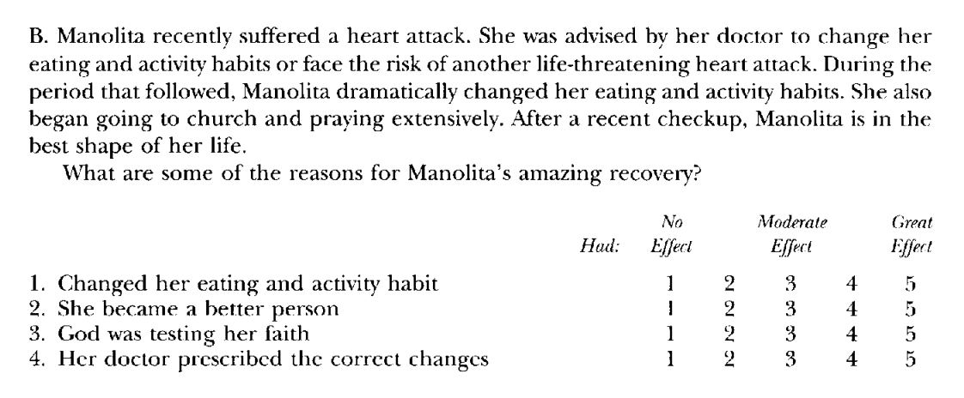
Methods
Four vignette groups
American 3rd point-of-view
American 2nd point-of-view
Japanese 3rd point-of-view
Japanese 2nd point-of-view
Cultural Health Attributions Questionnaire (CHAQ)

Slide 5
Normalization Attribute
Personal Attribute
Support Attribute
Stress Attribute
Notes:
Norm: sig. interaction culturexpov
japanese 3rd person seen as not normal, 2nd person seen as normal
US 3rd person seen as normal, 2nd person seen as not normal
Personal: sig. main effect pov
2nd pov both groups tended to blame themselves more than 3rd pov (higher negative self-stigma)
Support: sig. main effect culture
Japanese place more emphasis on support/environment
Stress: sig. main effect culture
Japanese sees general environment as a greater factor in affecting mental health

Slide 6
So What?
Better understand how Japanese look at mental health
Appropriate mental health services
Education
Notes:
Differences in cultures have changed compared to previous studies
By understanding how different cultures view mental health we can help organize more culturally appropriate mental health services and encourage minorities to seek help
Improve education of poor mental health and ”mental health literacy”
In other words, increase the amount of accurate knowledge the general public has about mental health

Slide 7
Acknowledgements
Thanks to the College of Wooster and Psychology Department for the opportunity to
complete this research and encouraging me to keep striving, especially my advisor Nathaniel Foster. Thanks to my friends and family for their continuous support and help throughout the process. Thanks to the individuals in Japan who helped connect and spread my study throughout Waseda University. And a special thanks to Karin Tompkins for the translation of the material into Japanese. I could not have completed this Independent Study without all of you.

Slide 8
Bignall, W. J. R., Jacquez, F., & Vaughn, L. M. (2015). Attributions of Mental Illness: An Ethnically
Diverse Community Perspective. Community Mental Health Journal, 51(5), 540–545.
Burns, J. R., & Rapee, R. M. (2006). Adolescent mental health literacy: Young people’s knowledge of depression and help seeking. Journal of Adolescence, 29(2), 225–239.
Cauce, A. M., Domenech-Rodríguez, M., Paradise, M., Cochran, B. N., Shea, J. M., Srebnik, D., & Baydar, N. (2002). Cultural and contextual influences in mental health help seeking: A focus on ethnic minority youth. Journal of Consulting and Clinical Psychology, 70(1), 44–55.
Cheng, H.-L., Wang, C., McDermott, R. C., Kridel, M., & Rislin, J. L. (2018). Self-Stigma, Mental Health Literacy, and Attitudes Toward Seeking Psychological Help. Journal of Counseling & Development, 96(1), 64–74.
Cheung, F. K., & Snowden, L. R. (1990). Community mental health and ethnic minority populations. Community Mental Health Journal, 26(3), 277–291.
Esping-Andersen, G. (1999). Social Foundations of Postindustrial Economies. OUP Oxford. Furnham, A., & Murao, M. (2000). A Cross-Cultural Comparison of British and Japanese Lay
Theories of Schizophrenia. International Journal of Social Psychiatry, 46(1), 4–20.
Kido, Y., Kawakami, N., Miyamoto, Y., Chiba, R., & Tsuchiya, M. (2013). Social Capital and Stigma Toward People with Mental Illness in Tokyo, Japan. Community Mental Health Journal, 49(2), 243–247.

Slide 9
Kido, Y., Kawakami, N., & WHO World Mental Health Japan Survey Group. (2013). Sociodemographic determinants of attitudinal barriers in the use of mental health services in Japan: Findings from the World Mental Health Japan Survey 2002-2006: Barriers to mental health service usage. Psychiatry and Clinical Neurosciences, 67(2), 101–109.
Kikuzawa, S. (2006). Multiple Roles and Mental Health in Cross-Cultural Perspective: The Elderly in the United States and Japan. Journal of Health and Social Behavior, 47(1), 62–76.
Kikuzawa, S., Pescosolido, B., Kasahara-Kiritani, M., Matoba, T., Yamaki, C., & Sugiyama, K. (2019). Mental health care and the cultural toolboxes of the present-day Japanese population: Examining suggested patterns of care and their correlates. Social Science & Medicine, 228, 252– 261.
Knifton, L., Gervais, M., Newbigging, K., Mirza, N., Quinn, N., Wilson, N., & Hunkins-Hutchison, E. (2010). Community conversation: Addressing mental health stigma with ethnic minority communities. Social Psychiatry and Psychiatric Epidemiology, 45(4), 497–504.
Koike, S., Yamaguchi, S., Ohta, K., Ojio, Y., Watanabe, K., & Ando, S. (2017). Mental-health-related stigma among Japanese children and their parents and impact of renaming of schizophrenia: Stigma in children and parents. Psychiatry and Clinical Neurosciences, 71(3), 170–179.
Landrine, H., & Klonoff, E. (n.d.). Cultural diversity in causal attributions for illness: The role of the supernatural. 13.

Slide 10
Mizuno, M., Yamaguchi, S., Taneda, A., Hori, H., Aikawa, A., & Fujii, C. (2017). Development of Japanese version of King’s Stigma Scale and its short version: Psychometric properties of a self- stigma measure. Psychiatry & Clinical Neurosciences, 71(3), 189–197.
Olafsdottir, S., & Pescosolido, B. A. (2009). Drawing the Line: The Cultural Cartography of Utilization Recommendations for Mental Health Problems. Journal of Health and Social Behavior, 50(2), 228–244.
Pescosolido, B. A., Monahan, J., Link, B. G., Stueve, A., & Kikuzawa, S. (1999). The public’s view of the competence, dangerousness, and need for legal coercion of persons with mental health problems. American Journal of Public Health, 89(9), 1339–1345.
Ross, S. G., Bruggeman, B., Maldonado, M., & Deiling, M. (2019). Examining Personal, Perceived, Treatment, and Self-Stigma in College Students: The Role of Parent Beliefs and Mental Health Literacy. Journal of College Student Psychotherapy, 1–15.
Sai, G., & Furnham, A. (2013). Identifying depression and schizophrenia using vignettes: A methodological note. Psychiatry Research, 210(1), 357–362.
Saint Arnault, D., & Woo, S. (2018). Testing the influence of cultural determinants on help-seeking theory. American Journal of Orthopsychiatry, 88(6), 650–660.

Slide 11
Sheikh, S., & Furnham, A. (2000). A cross-cultural study of mental health beliefs and attitudes towards seeking professional help. Social Psychiatry and Psychiatric Epidemiology, 35(7), 326– 334.
Vaughn, L. M., Jacquez, F., & Baker, R. C. (n.d.). Cultural Health Attributions, Beliefs, and Practices: Effects on Healthcare and Medical Education. 11.
Watson, A. C., Otey, E., Westbrook, A. L., Gardner, A. L., Lamb, T. A., Corrigan, P. W., & Fenton, W. S. (2004). Changing Middle Schoolers’ Attitudes About Mental Illness Through Education. Schizophrenia Bulletin, 30(3), 563–572.
Wells, K., Klap, R., Koike, A., & Sherbourne, C. (2001). Ethnic Disparities in Unmet Need for Alcoholism, Drug Abuse, and Mental Health Care. American Journal of Psychiatry, 158(12), 2027–2032.
Yeh, M., McCabe, K., Hough, R. L., Lau, A., Fakhry, F., & Garland, A. (2005). Why bother with beliefs? Examining relationships between race/ethnicity, parental beliefs about causes of child problems, and mental health service use. Journal of Consulting and Clinical Psychology, 73(5), 800–807.
Zea, M. C. (2000). The development of the Cultural Health Attributions Questionnaire (CHAQ). Cultural Diversity & Ethnic Minority Psychology, 6(3), 268–283.

