Slide 1
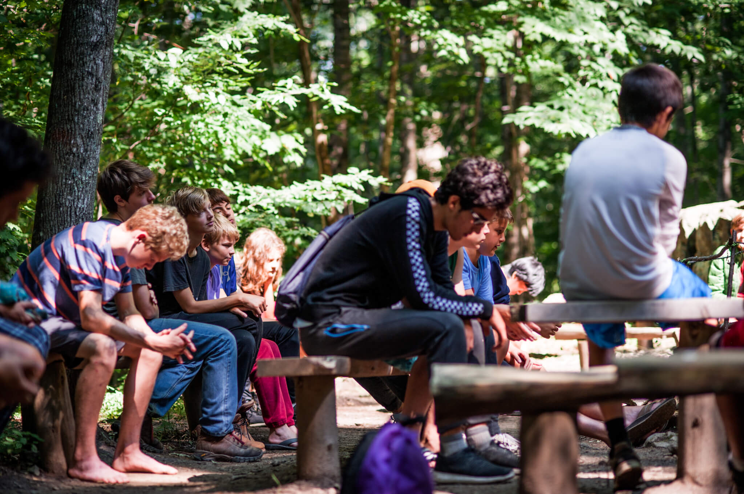
Elise Nikolich
Advised by Jeremy Rapport
Religious Studies major, Environmental Studies and Chemistry minors
Virtual IS Symposium 2020
Being Moved by the Wild:
A Study of Wilderness Spirituality and the Outdoors as a Tool for Retention and Recruitment in Quaker Communities

Slide 2
“The produce of the Earth is a gift from our gracious creator to the inhabitants. To impoverish the Earth now to support outward greatness appears to be an injury to the succeeding age.”
-John Woolman, 1772

Slide 3
Quakerism and the Outdoors
Things to consider:
Quakerism is a protestant sect centered around the idea that there is “that of God” or “the Light” in everything and it is our responsibility to honor that in everyone and everything
Quakers do not live in isolated communities. Much like majority sects, they live modern lives and every Sunday at a Meeting House or Friends Meeting
The faith uses a practice known as Meeting for Worship that allows members to sit in silent community together until someone is moved by the light or the spirit to speak out of the silence
Quakerism is based upon testimonies, rather than a creed, that are most often represented with the acronym S.P.I.C.E.S.: Simplicity, peace, integrity, community, equity, and stewardship
They offer lots of programming that encourages practitioners to create community, as well as experiencing it in the outdoors

Slide 4
Methods
A three-pronged approach:
A survey
Distributed through Facebook groups associated with Quaker organizations and those organizations found in Quaker testimonies, as well as larger open Quaker groups
~250 responses
Interviews
Three interviews were conducted with select leaders from organizations creating experiences of Quakerism or the Quaker testimonies in the outdoors
An investigation of Quaker history and the context surrounding these experiences
Compiled historical documents from Quaker leaders speaking to the connection between Quakerism and the outdoors
Compiled accounts of collective effervescence (community) and affective bonding (personal connection) as external factors leading to the outdoors as a retention and recruitment tool

Slide 5
Survey Data
What the data says:
Survey responses were broken into three groups based on external forces at playing during people’s first experiences of Quakerism
From birth retention
Recruitment from involvement
Adulthood recruitment
Trends towards the outdoors as a significant recruitment tool and a less but still significant trend towards the outdoors as a retention tool
Programming serves as pathways but is heavily concentrated in younger ages therefore higher rates of first experiences of Quakerism in the outdoors occurs between the ages of 9 and 18
Indication that community forces and personal connection to other community members serve as an important role in trends towards the outdoors as a useful retention and recruitment tool

Slide 6
Intentions
Interviews indicated:
The importance of the outdoors in understanding not only individuals, but also Quakerism
The importance and attraction of community as a way to connect to these experiences
That Quakerism, the outdoors, and community, cannot be truly separated and evaluated as such
That the Quaker testimonies encourage closeness to the natural world and that these experience foster faith experiences
That because of all of these factors, outdoor programming can be used to draw people into the community and therefore closer to the faith

Slide 7
External Factors
External Factors:
There are proven positive psychological impacts of the outdoors and Nature on personal
Improves mental health
Fosters connection building
Over-whelming feelings of peace and connection
Affective bonding, or personal connections, make individuals more likely to identify with a faith or group
Collective effervescence, or connection and affection for a community, serves as a uniting factor that is attractive to individuals and serves as an additional factor in retention

Slide 8
Wilderness Spirituality
Previously defined as:
“A feeling of connection and interrelationship with other people and nature; a heightened sense of awareness and elevated consciousness beyond the everyday and corporeal world; cognitive and affective dimensions of human understandings embracing peace, tranquility, harmony, happiness, awe, wonder, and humbleness; and the possible presence of religious meaning and explanation.” (Ashley, 2007)
New three-part framework based upon this definition and others, as well as personal accounts from surveys and interviews:
A description of the spaces in which such experiences take place
An identification of the relationship between such experiences with self
an identification of the benefits of such experiences, both in- and extrinsic
This new framework allows space for difference of experience as well as perspective to be incorporated into the definition and therefore broader application

Slide 9
Conclusions and Looking Forward
Conclusions:
Experiences of Quakerism in the outdoors foster increased retention and recruitment, particularly in those exposed to such experiences aged 9 to 18
This is fostered by the space, Quaker testimonies, community, personal connection and the intentions of those shaping and planning such communities
Broader definition offers a more inclusive approach to wilderness spirituality that offers space for both personal and religious interpretations as well as greater access
Further Applications:
Other faith communities: This would require great consideration of faith specific doctrine in facilitating this positive relationship, but community and personal connection serve as significant cofactors to experiences in the outdoors
Further application of the definition of wilderness spirituality based on the more open and accessible three-part framework can be done to further pin-point this academic area of interest for many

Slide 10
“Only when we see that we are part of the totality of the planet, not a superior part with special privileges, can we work effectively to bring about an earth restored to wholeness.
Darkness is no less desirable than light. It is rather, a rich source of creativity… First there is the darkness of the earth in which the seeds wait all through the winter. Second, there is the darkness of the womb in which the young mammal grows into sufficient viability to be born and take its place on earth, as a separate being…. And third, there is the darkness of night, when the garish sun has gone down and the things of earth are blotted out, and we may glimpse the vastness of the universe of which we are part… “
-Elizabeth Watson, 1996

